Slide 1

Sustainable Scholars
Bridging Sustainable Development with Education. Sustainable Scholars is an online platform empowering the next generation to address climate change through interactive learning.
By Neo Sphere

Slide 2
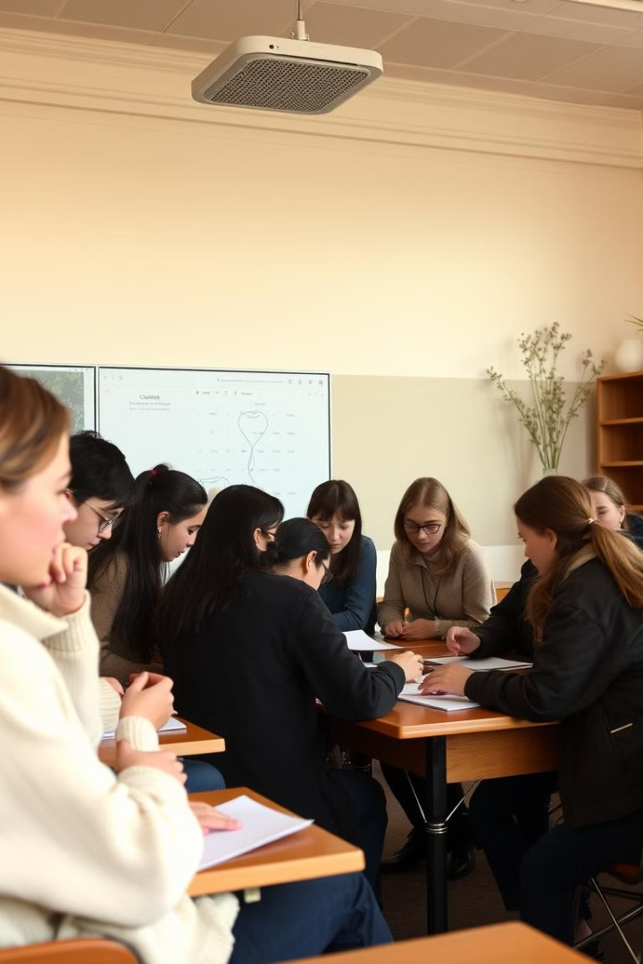
Integrating SDG 13 in the Classroom
1
Climate Action Gap
2
Educator Demand
Climate change is a pressing issue, yet there is a lack of formal education on climate action.
94% of educators globally want to incorporate sustainable development, but lack the necessary tools and resources.
3
Our Solution
Sustainable Scholars provides a platform to seamlessly integrate SDG 13 into existing curricula.

Slide 3
Interactive Online Courses
Cutting-Edge Tech
Gamified Learning
Curriculum Alignment
Built with HTML, CSS, JavaScript, Dart, and Django for seamless integration, scalability, and cross-platform performance.
Courses feature interactive experiences, simulations, and climate action challenges.
Content aligned with science, geography, and social studies standards for easy integration.

Slide 4

Modular Integration
1
Plug-and-Play
SDG 13 modules can be easily integrated into existing science units.
2
Teacher-Friendly
Resources include lesson plans, videos, and interactive quiz activities and a query chatbot.
3
Scalable Model
Can be used across different subjects beyond science, such as social studies.

Slide 5

Validation Roadmap
Pilot Programs
Surveys & Interviews
Launch beta versions in select schools to gather user feedback.
Collect data from educators and students to refine content and functionality.
Key Metrics
Partnerships
Engagement rates, educator feedback, and student performance improvements.
Collaborate with firms to expand content and reach.

Slide 6





Unique Value Proposition
Curriculum-Aligned
Interactive Learning
Designed to meet educational standards for multiple regions.
Fosters student engagement with gamification and real-world problem solving.
Ease of Use
Scalability
No technical expertise required, with a comprehensive teacher toolkit.
Built on modern tech stack for smooth deployment across devices.

Slide 7




Join the Movement
Empower Students
Equip the next generation with knowledge to combat climate change.
Integrate SDG 13
Take concrete steps to incorporate climate action into your curriculum.
Vision
Empower the next generation to combat climate change through education.

Slide 8
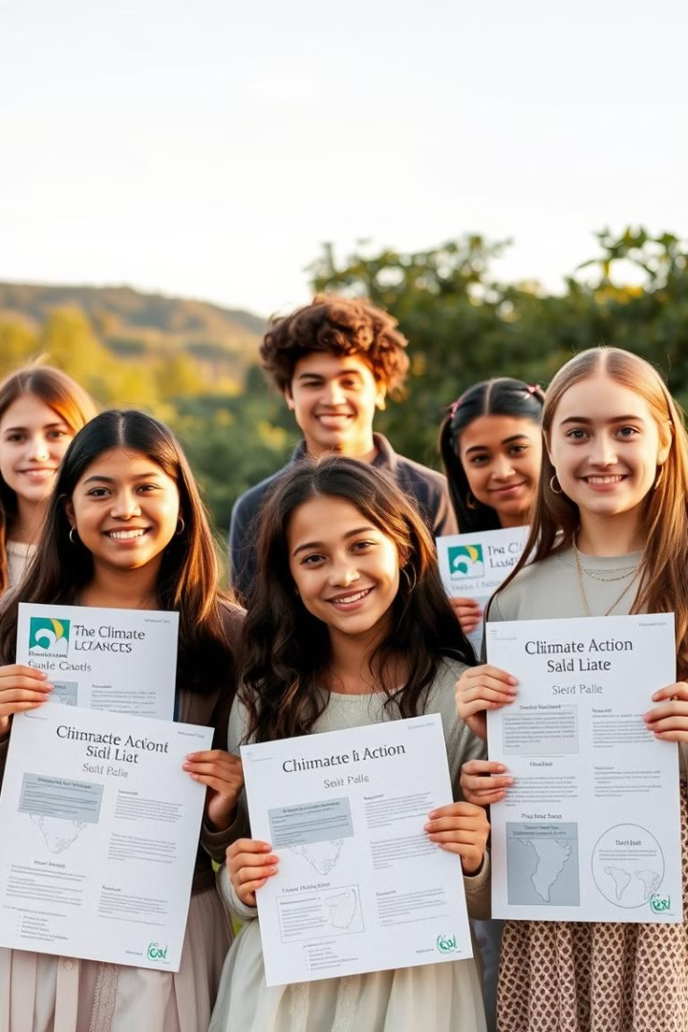
Conclusion
Vision
Empower the next generation to combat climate change through education.
Mission
Integrate Sustainable Development Goal 13 into classroom learning.
Call to Action
Join us in this movement to equip students with the knowledge and skills to make a real-world impact.

